Slide 1
Timetables

Slide 2
LO: To interpret and use timetables Know: that the concepts of time (hours, minutes, days) how to read a clock Understand: that timetables help us organize time Do: I interpret and use timetables

Slide 3
24
7
30
Date
Timetables
EQ – How I read, interpret and use a timetable?
Timetables help us organise schedules. There are many different types of timetables in our everyday lives such as bus, TV, movie and even class timetables.
We need to calculate elapsed time in order to work out timetables.
Summary:
5

Slide 4
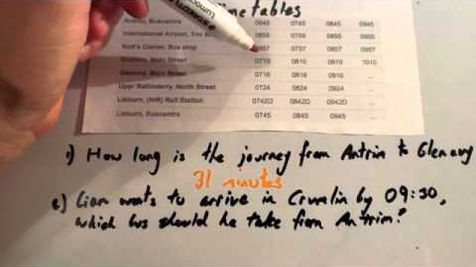

Slide 5
I Do
If I want to catch the train to Perth that departs Mandurah at 11.42am, what time do I need to be at the Warnbro station in order to catch it?
How long will the trip to Perth Underground take?

Slide 6
We Do
When leaving Perth, I want to get the train that will get me to Warnbro by Midnight as I’m being picked up then.
What is the latest train I can get?
How long will the trip take?

Slide 7
You Do.
Using the Simpsons Timetable, answer the questions and then calculate how long each trip will take..

Slide 8
Extension Question.
Three trains travel from City Station to Farmland Station on the same morning. The Express leaves City 10 minutes after the All Stations train, but arrives at Farmland 10 minutes before it.
The All Stations takes 50 minutes to reach Farmland and arrives at 10:30.
The Goods train leaves 20 minutes before the All Stations and arrives at Farmland 20 minutes after the Express.
Work out the timetable. That is; what time does each train leave City Station and what time does each train arrive at Farmland Station?

Slide 9
Think, Pair, Share.
Think - Take 1 minute to think about how we read timetables and calculate the time a trip takes.
Pair – Spend 2 minutes telling your partner how you would read a timetable and calculate the time a trip takes.
Share – Find 1 other person in class you don’t normally speak to and share with them, your strategies.

